Slide 1


Kammelna Project
By
Abdullah Nasser Almohsen
Saeed Abdullah Alghamdi
Saleh Khaled Alenzi
Supervised by: Dr. Mohammed Assiri
Year: 2023

Slide 2

Introduction
Kammelna is an app game for the most popular cards games in Saudi Arabia "Baloot بلوت-–:". This app allows its users to play Baloot online with other users in around the world. This app has an easy and simple interface to use. In this app, you can create private rooms in order to play with friends. Also, you can join public rooms with other players. Overall, Kammelna is a very good choice for Baloot players who want to play the game in anytime and anywhere with players around the world.

Slide 3

Problem
Baloot players need an easy way to play Baloot, because not all the time players can play with theirfriends every day, so Kammelna app provides playing on a daily basis, The player needs to play with their Friends who are in other places or regions. The professional Baloot player wants to play in tournaments. The beginner player needs to be trained practically to play Baloot.

Slide 4

Background
Kammelna : is an app game allows its users play Baloot online. You can play it either with friends or with other players in the world. The app is free and there is a subscription that gives extra features. One of the best features in the app is theranking system which determines the level of the player to put the player with other players who has the same level to make the game is competitive and fun. Kammelna has great popularity in the Arabian countries especially in Saudi Arabia because Baloot is which is one of the most popular card games. You can play it anytime and everywhere.

Slide 5

Solution
Kammelna app offers several solutions and features that help users enjoy the game and improve their experience. The features of these solutions are as follows:
1-Playing with Artificial Intelligence: Kammelna app
offers the option to play with Artificial Intelligence,
where users can play against the computer that
features an adjustable difficulty level to improve their skills in the game.
2-Playing Online: Kammelna app offers the option to
play with other players online, where users can enjoy the game with their friends or other players from all
over the world.
3-Quick Play: Kammelna app allows users to play the
game faster and more efficiently by adding Quick Play
options and reduces the time consumed in the game.

Slide 6
Solution
4-Customizable Game Options: Kammelna app offers
customizable game options, where users can change the background, colors, and settings to make the game experience more suitable and personalized.
5-Statistics and Progress Tracking: Kammelna app
allows users to track their progress in the game and
know the statistics related to their performance by
displaying detailed statistics and reports that show the
winners, losers, and win rates.
6-Game Guide: Kammelna app includes a guide for
users that explain how to play and the rules, and users
can refer to it at any time during a game.
7-Technical Support: Kammelna app provides technical
support for users, where they can contact the support team to get help in solving any problems they encounter in the game or to provide any inquiries or Suggestions for improving the game. The game is also regularly updated to maintain its quality and improve the user experience.

Slide 7

Work plan
If we are the ones who create the app, we will do the following:
First, we need to understand and figure out the requirements and features needed to the app and record it. Also, we need to record users needs and record the problems in apps that have the same idea.
Second, we need to design a simple, well-looked user interface.
Third, we need to start software development with the suitable programming language to develop the app on iOS devices and Android devices.
Fourth, we need to conduct extensive testing to ensure that the app works and interacts properly with users without glitches or problems.

Slide 8
Work plan
Fifth, after testing and checking that the app works properly, we need to release the app on applications stores (App Store for iOS devices and Google Play for Android devices).
Finally, we need to continue to monitor, maintain, and update the app regularly to improve performance, fix bugs, and update and add features.

Slide 9
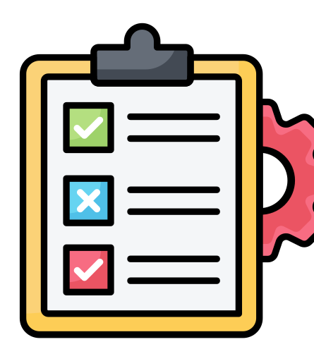
Project requirements

Slide 10

Functional requirements
Technical support: this is essential functional requirements in many in case any problems, glitches, crashes, or cheating cases happening in Kammelna.
Creating account and signing in: The app must allow the users to create their own accounts and login using their username and password. Also, The system must allow users to log in with their Google and apple accounts.
account management: the users can change their account information at any time.

Slide 11
Functional requirements
Record the results and progress: the moves of the players and their progress must be recorded at the same time the points are recorded and updated automatically.
Creating rooms: the users are able to create public or private room to play and inviting friends to join them the games.
Text Chatting and voice chatting (users communication):
The users are able to communicate with each other in the middle of the game through text messages or voice chatting.

Slide 12
Functional requirements
The system must allow users to reset their password by clicking on "I forgot my password" and receiving a link to their verified email address.
The system must allow the user to submit feedback through a contact form in the app.
The system should allow the user to buy coins (currency in the game) from the app.

Slide 13
Functional requirements
Users can enter credit card information or use Apple Pay to buy the coins.
The system must allow users to buy via Apple Pay or STC Pay.

Slide 14

Non-Functional requirements
-Ease of use: The app should be easy to learn and use, the app should have a simple and clear user interface that contains clear explanations to it and some tutorials and instructions
• The training time should not be more than 3 minutes.
-The good performance: The app should be working smoothly and without delay, especially with the fast playing from the players, this is done by updating and improving the algorithms and the techniques that have been used and the app.
• Each event shall be done within 2 seconds.

Slide 15
Non-Functional requirements
-Compatibility: The app should support different devices. For example, smart phones, tablets, and computers. Also, the app should support multiple operating systems. For example, iOS, Android, Windows, and Mac.
• Our goal is to make the app available in many devices.
-Support multiple languages: apart from Arabic language, the app should offer some of the most popular languages. For example, English, French, Hindi and Chinese.
• Our goal is to support many languages to make the app widespread.
.

Slide 16
Non-Functional requirements
-Availability: The app should be working 24/7 non-stop. That is done by coming up with dependable and strong servers.
• The Rate of failure occurrence should be less than 1% in each day.

Slide 17

Activity diagram

Slide 18
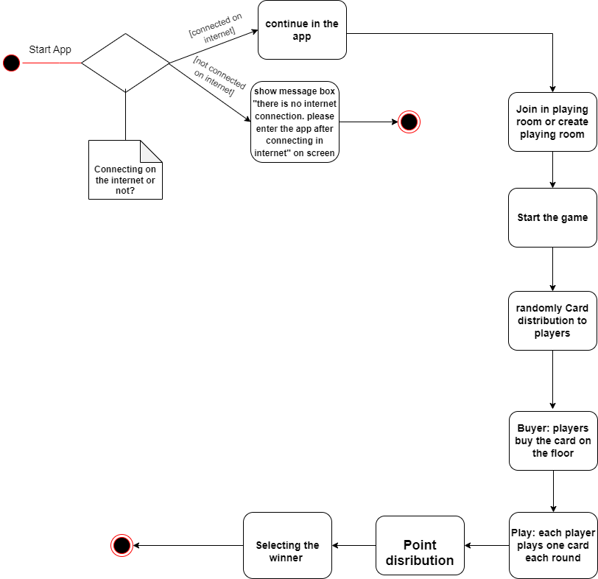
Activity diagram if the user did not create an account or log in in the app.

Slide 19
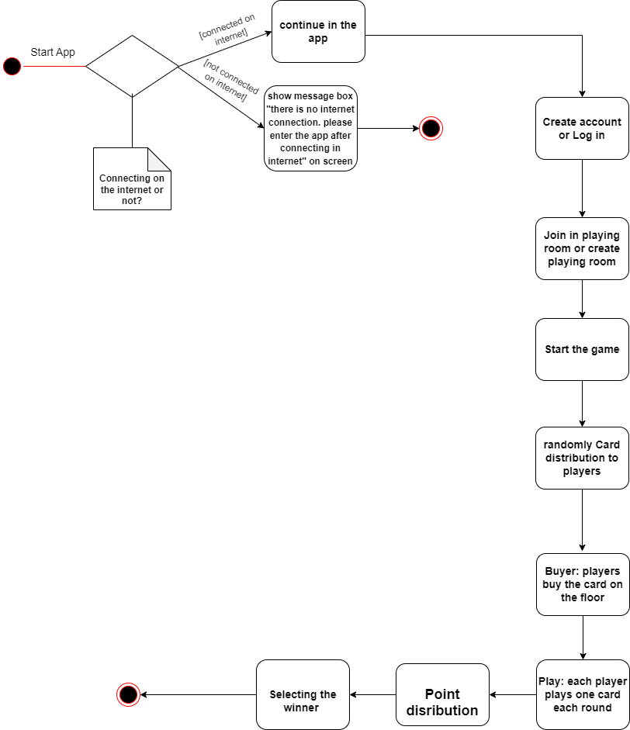
Activity diagram if the user did log in in the app.

Slide 20

Project Use Case Diagram

Slide 21
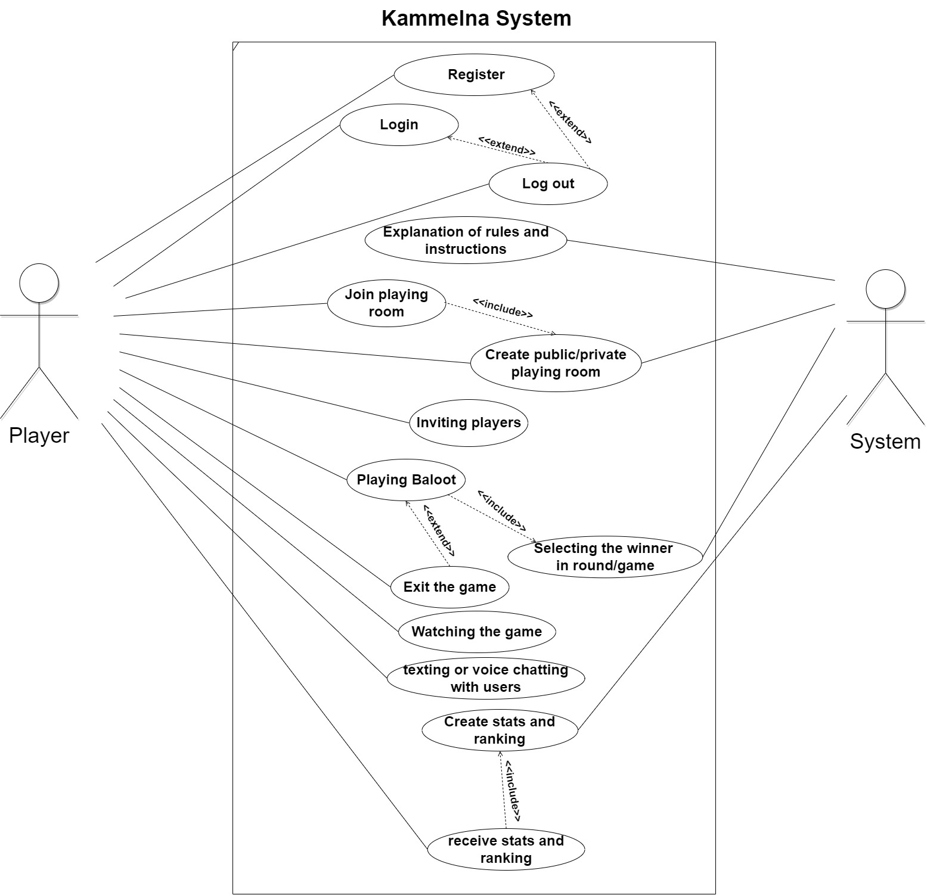
Project Use Case Diagram

Slide 22

Class Diagram

Slide 23
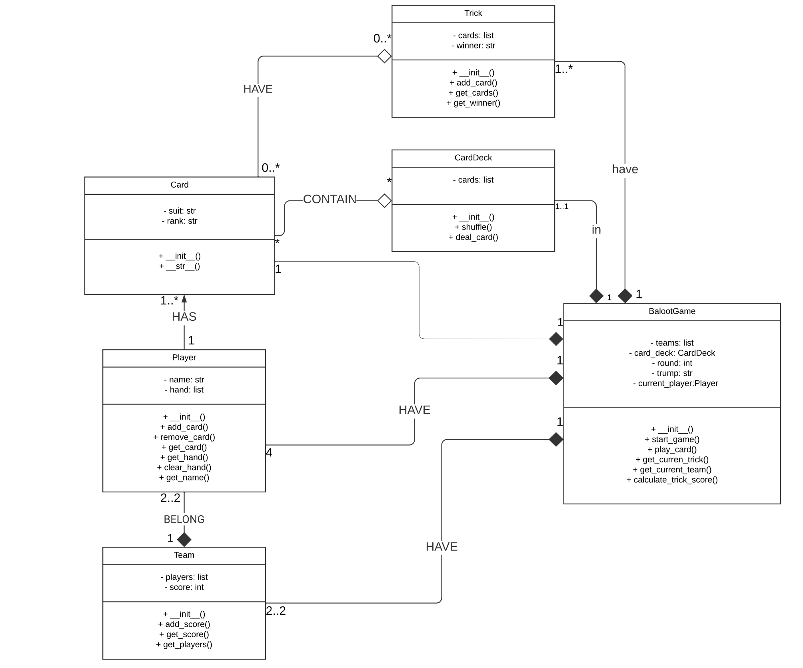
Project Class Diagram

Slide 24
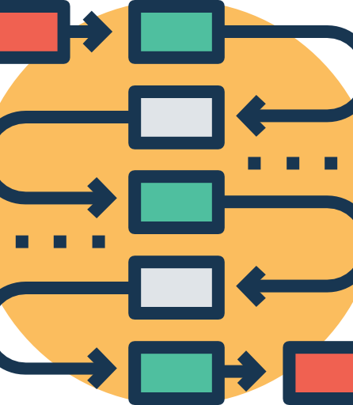
Sequence Diagram

Slide 25
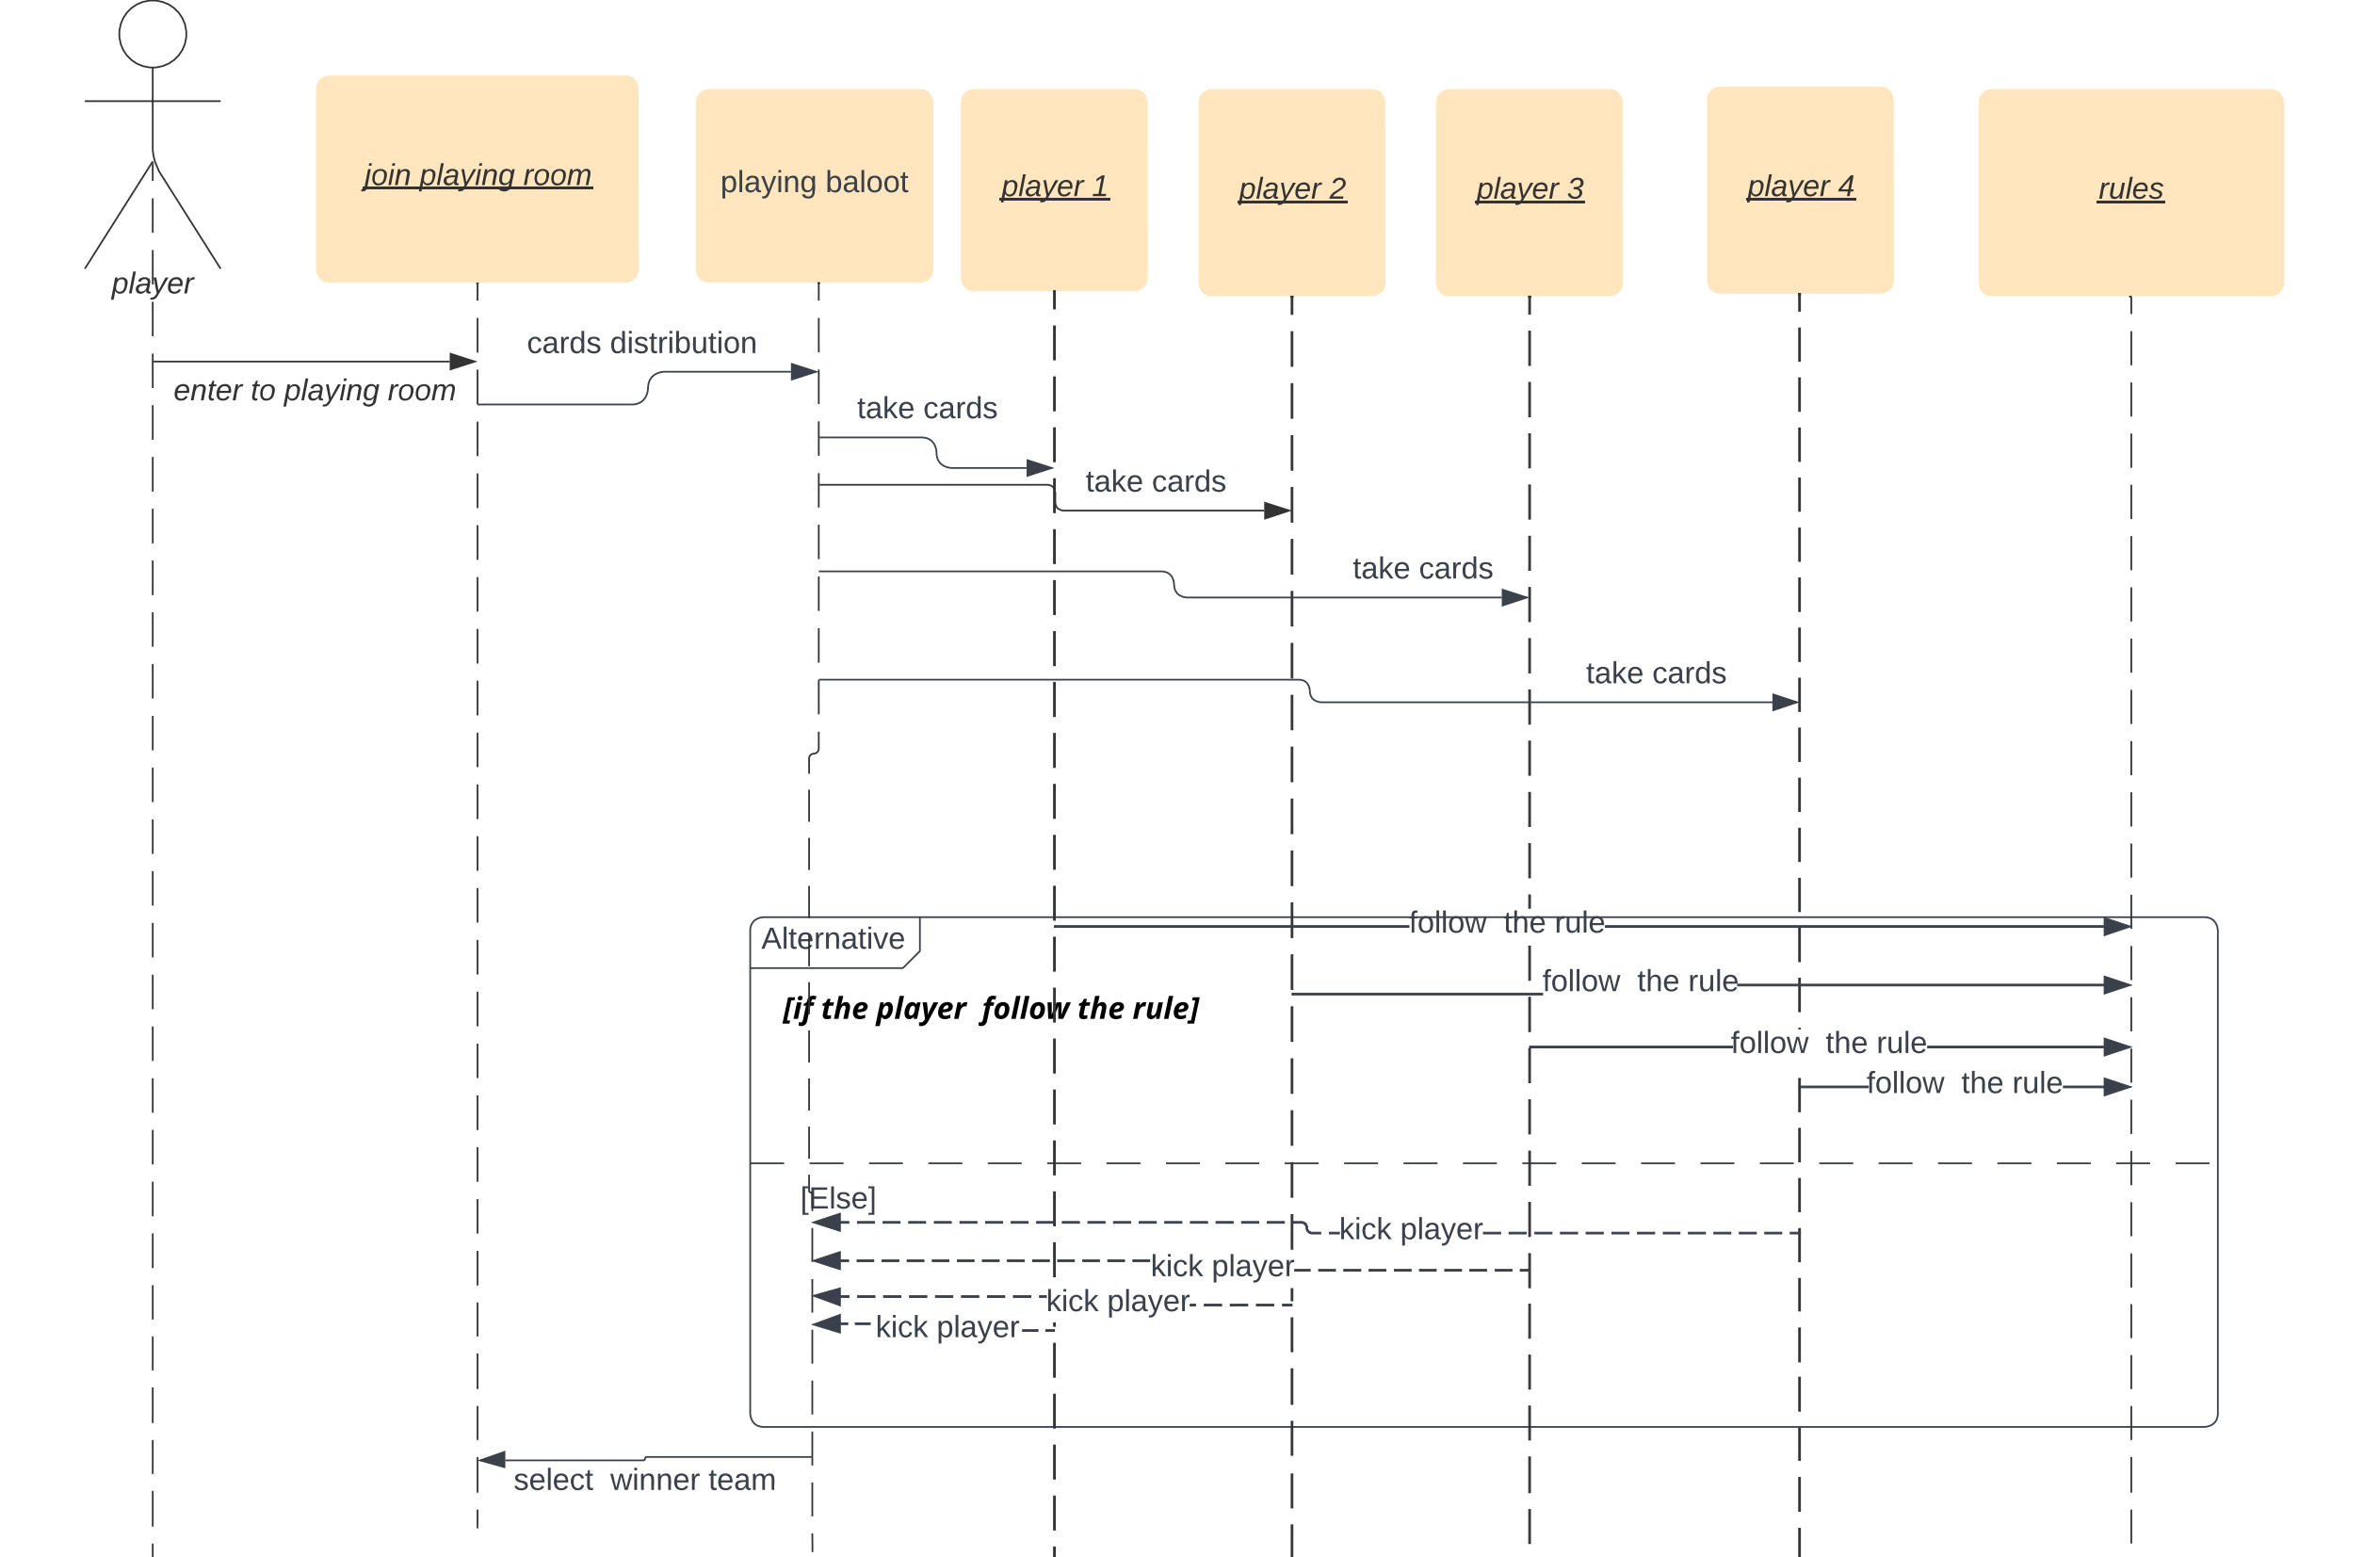
Project Sequence Diagram

